Slide 1

Road Accident Analysis
Understanding the patterns and causes of road accidents is crucial for improving road safety and saving lives.
by Nandini Mishra
Last Update: 17-NOV-2024

Slide 2
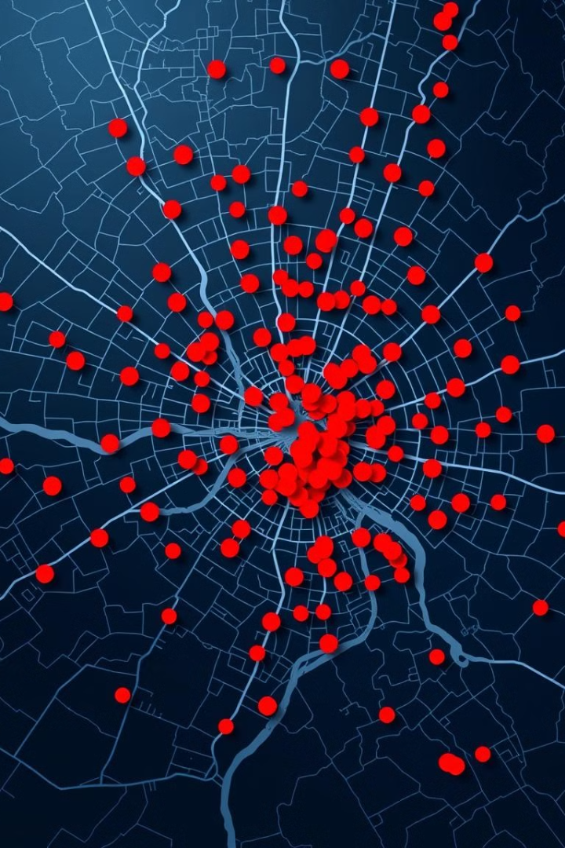
Introduction: Importance of understanding road accident patterns
1
Identifying Pattern
2
Preventing Future Accidents
Analyzing accident data reveals patterns that help to understand the contributing factors to accidents.
By identifying common causes and trends, effective interventions can be implemented to mitigate risk factors.
3
Improving Safety
Understanding accident patterns allows for targeted safety improvements, such as road infrastructure upgrades or driver education programs.

Slide 3
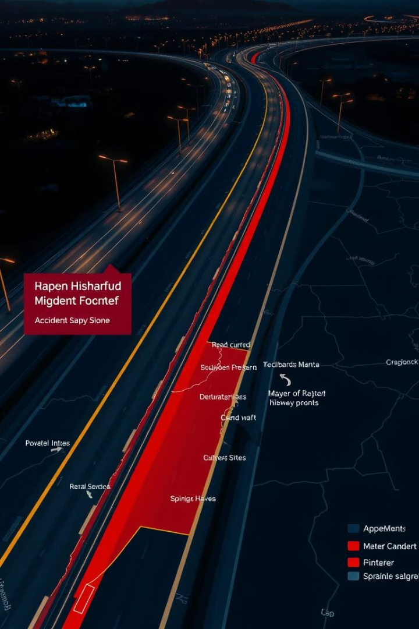

Objective
Analyzing accident data to know at what speed major casualties took placed.
Do Road surfaces, climatic Condition lead to more casualties.
From urban area or rural area , which one is major the hotspot to the casualties.
Comparing the casualties of both the year (2021-22) to know what all the factors affected that particular year.
Total casualties happened in both the year and injury happened were major or minor.

Slide 4

Data Sources: Accessing reliable accident data
The data has been acquired from online source in excel format.
After that I cleaned the data, check the format remove null values, duplicate values , outliers(detect anomalies in data),if needed change the data type of the data.
After that I have created some of the visualization affecting the road accident to create a report.
Raw data

Slide 5

Analyzing Contributing Factors: Driver behavior, road conditions, vehicle factors
Driver Behavior
Speeding
Road Conditions
Poor lighting, potholes, slippery surfaces
Vehicle Factors
Type of vehicle

Slide 6
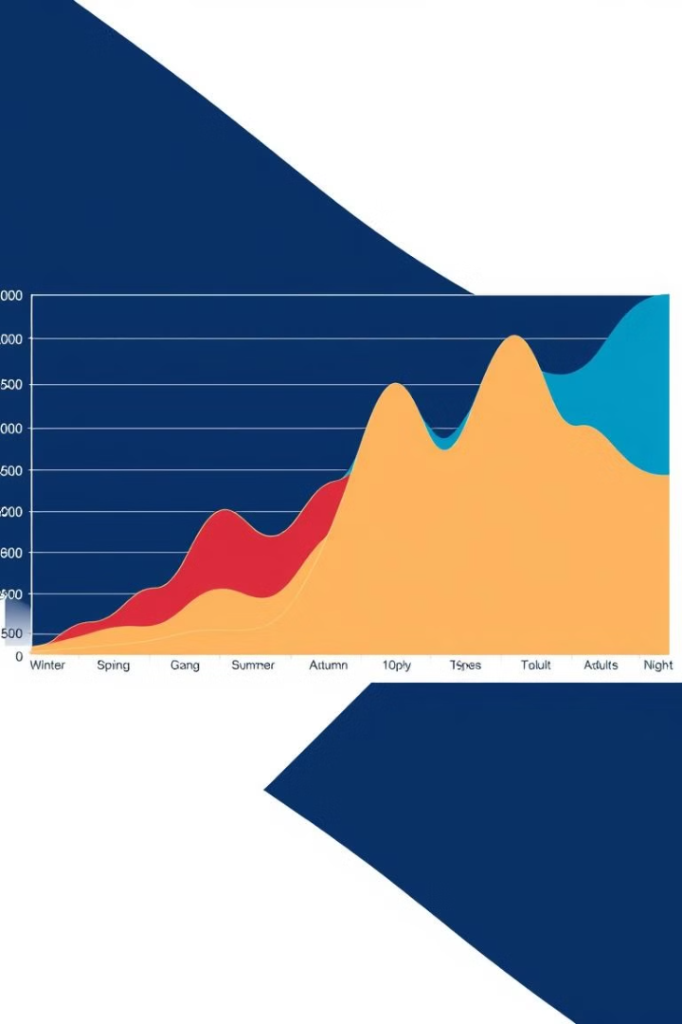
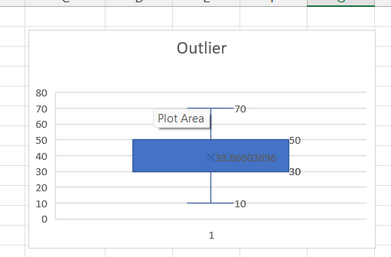
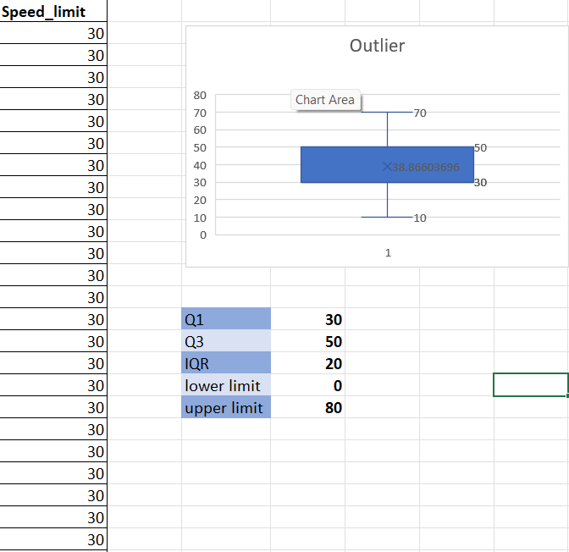
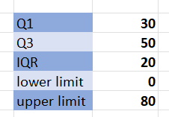
Outlier
Data point that is significantly different from the majority of other data points in a set can change the central tendency of data(mean ,median).
Box plot whisker and IQR range were find to know weather dataset contain outlier or not, so here dataset doesn’t contain any outlier.

Slide 7
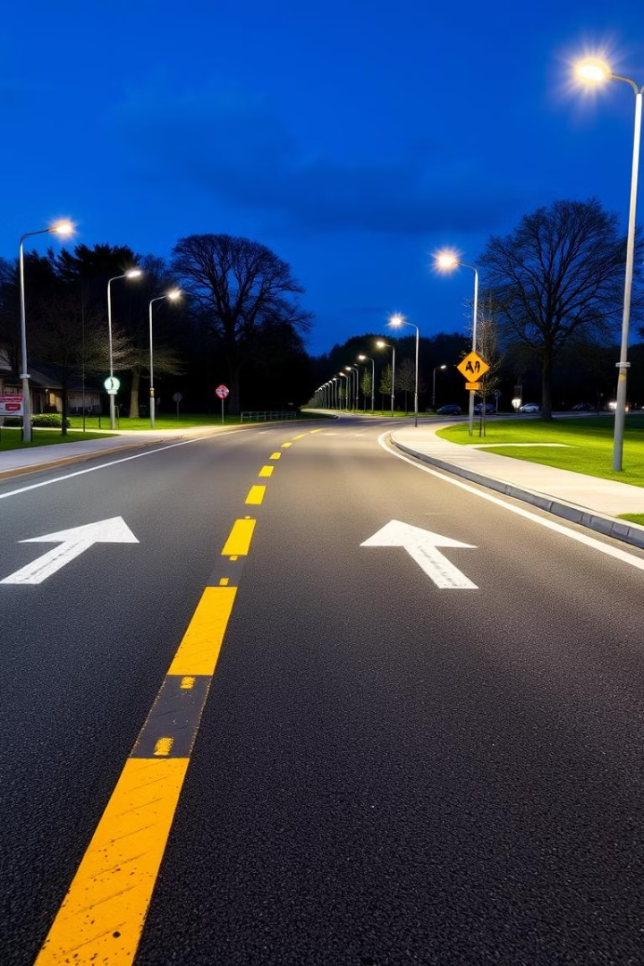
Percentage of casualties
Insights
Fatal Casualties
Serious Casualties
Here I have used DONUT CHART to represent the individual contribution in a whole data series
Similar to Pie chart, can show numeric value as percent but has hollow centre
i.e. there is no centre.
Slight Casualties

Slide 8
Insights
Casualties 2021 vs 2022
Here I have used Line chart to know the relationship between two variables or trend.
It is similar to scatter plot, just connect the points single line in a scatter plot.

Slide 9
Insights
Here I have used scatter line plot to know at what speed the casualties took place were high.
Casualties by Speed

Slide 10
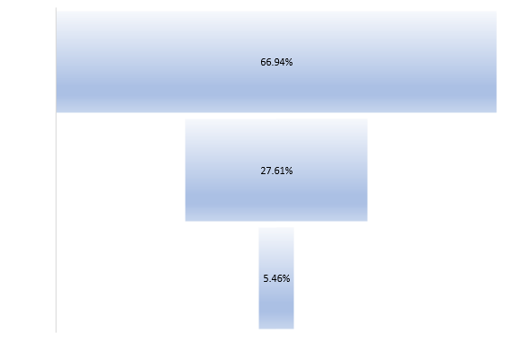
Insights
Casualties by weather
Here I have used Funnel chart to know the flow of sequential process, with each state
By a bar that decreases in length.

Slide 11
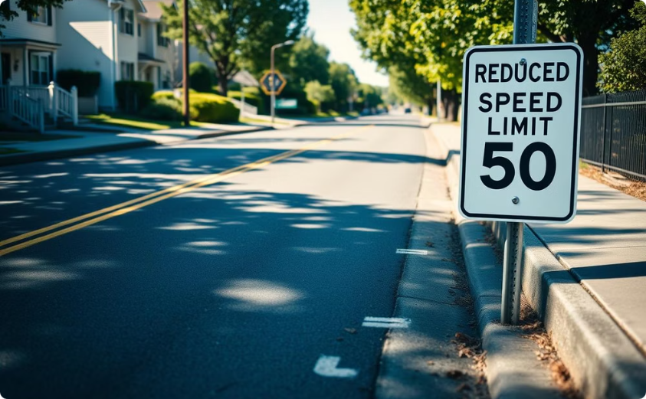
Insights
Casualties by Road surface
The bar charts are used to show the comparisons between different variables. It is very easy and convenient to visualize the parameters in a pictorial form.
It helps in studying patterns over long periods of time

Slide 12
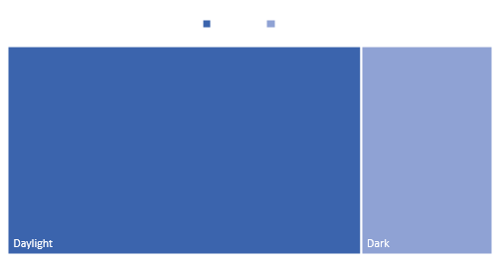

Insights
Casualties by condition
Treemaps best depict data that needs to show a part-to-whole relationship. Percentages of a measure for each dimension are displayed as squares that, when added together, comprise the whole follows a hierarchy.

Slide 13





Conclusion: Key takeaways and next steps
Emergency response
Multi-Disciplinary Collaboration
Continuous Monitoring ,Evaluation. updates
Quick and efficient emergency responses can reduce the severity of injuries and fatalities, highlighting the importance of having trained medical personnel and emergency services available.
Collaboration between traffic engineers, law enforcement, and public health officials is crucial to addressing complex safety issues, Insurance company can revise their life insurance plans.
Regularly evaluating the effectiveness of safety interventions and adjusting strategies Providing timely weather updates, improving road drainage, and ensuring proper road design for various weather conditions.

Slide 14


